Slide 1
Measuring impact
@IWMW 2012 (Edinburgh)
Stephen Emmott
LSE

Slide 2
Background

Slide 3
LSE
LSE is a specialist university with an international intake and a global reach. Its research and teaching span the full breadth of the social sciences, from economics, politics and law to sociology, anthropology, accounting and finance. Founded in 1895 by Beatrice and Sidney Webb, the School has an outstanding reputation for academic excellence. LSE has 16 Nobel prize winners.

Slide 4
About LSE
23 academic departments
16 research centres
9,500 students (800 PT; 2/3 overseas)
3,000 staff (1,300 PT; 44% overseas)
1 campus with footprint similar to, perhaps smaller than, that of the Pollock Halls site.

Slide 5
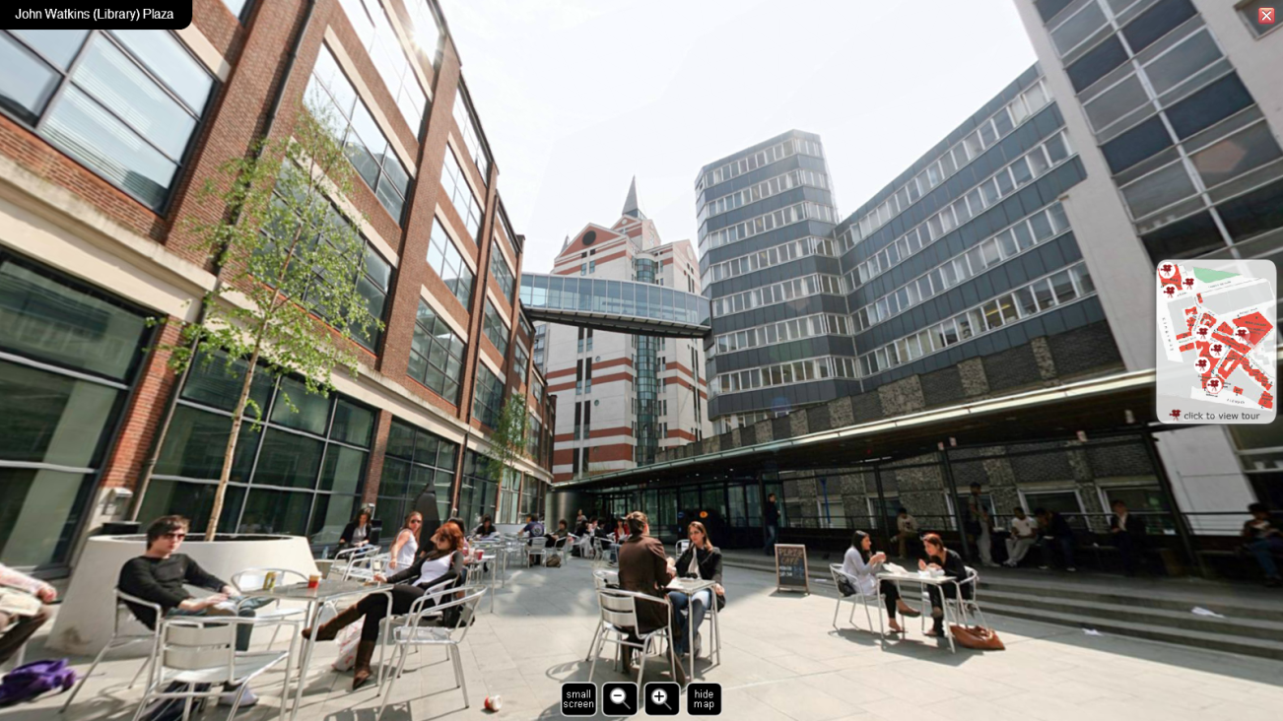

Slide 6
About me
Stephen Emmott
Head of Web Services
Web Services is within Communications, which is within External Relations.
Lead and manage web services… but what is web services these days?

Slide 7

Roy Lathwell - Creative Commons Attribution 2.0 Generic
See: http://commons.wikimedia.org/wiki/File:Salmon_leaping_at_the_Falls_of_Shin,_Scotland.jpg

Slide 8
CONTEXT

Slide 9
Position in hierarchy
Director
  Pro-Director (Research; External Relations)
    Director of External Relations
      Head of Communications
        Head of Web Services

Slide 10
What is ‘Web Services’?
What isn’t it? ;)
People
Systems
Servers
Processes
Services
…

Slide 11
People
9 people (3 sub-teams: editorial/content, rich media and production)
~500 editors/contributors
Internal suppliers (1 (IT); all?)
External suppliers (~15)

Slide 12
Systems (software)
CMS - Contensis by Genetics
Search facility - Funnelback by Funnelback
Usage monitoring and reporting - Digital Analytix (SiteStat) by ComScore (NedStat); Google Analytics by Google; Stone Steps Webalizer by Stone Steps.
Blogs - WordPress by WordPress Foundation
QA - Web Governance Suite (Response; Quality Assurance) by SiteImprove
Media Streaming - FMS by Adobe, through Influxis
...

Slide 13
Systems (servers)
CMS, search, blog and other servers hosted by IT Services/SunGard
NAS, DB and web servers hosted by IOMART
Rich media server hosted by Influxis
CWP hosted by SunGard
...

Slide 14
Processes
Updating/publishing home pages.
Developing templates and deploying changes.
Detection and restoration of service upon outage.
Archiving and deleting pages.
Detecting and correcting broken links.
Support for editors/contributors through web surgeries.
...

Slide 15
Services
The constituent parts of what we call our ‘web presence’.
Hosted at LSE and owned by LSE.
Hosted elsewhere and owned by LSE.
Hosted elsewhere and owned by others.

Slide 16
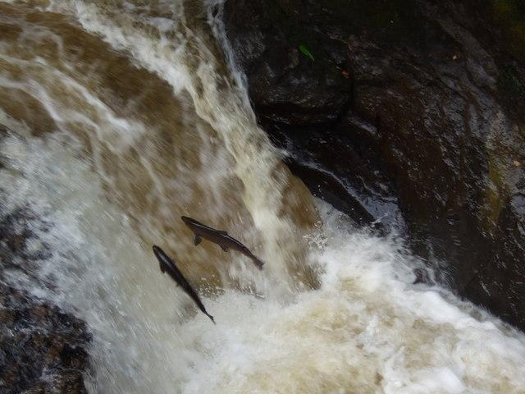
Geojoc - Creative Commons Attribution-Share Alike 2.0 Generic
See: http://en.wikipedia.org/wiki/File:Salmon_leaping_at_Buchanty_Spout_on_River_Almond_-_geograph.org.uk_-_1347586.jpg

Slide 17
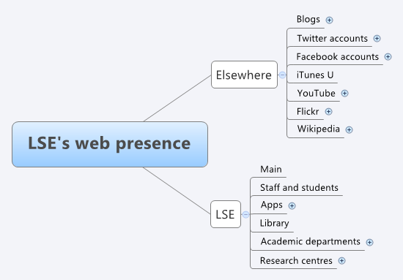
Web presence

Slide 18
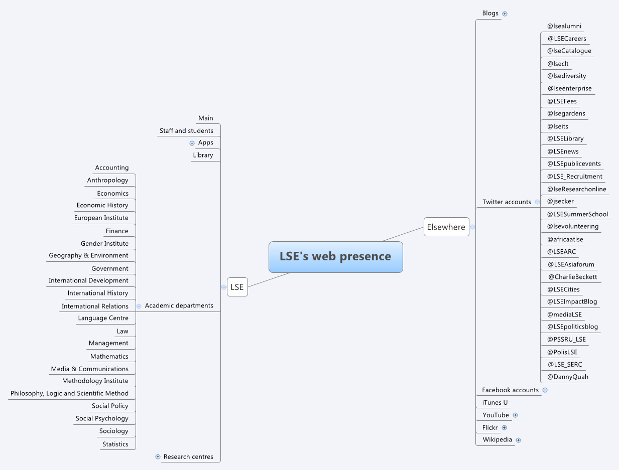
Web presence (partially expanded)

Slide 19
MEASUREMENT

Slide 20
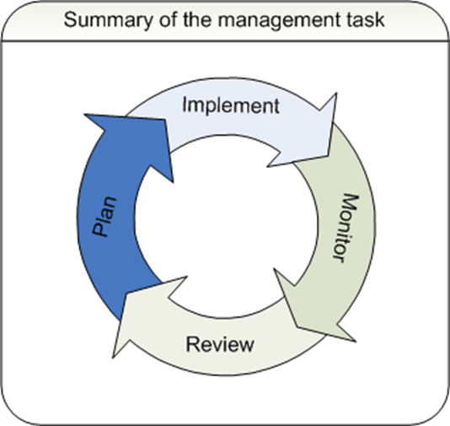
Why measure?

Slide 21
Instruments/measurements
Log files eg server requests, etc.
Web beacons or bugs/pixel tags
Cookies
Application-specific
Any others?
[audience asked to contribute during presentation]

Slide 22
Analysis of measurements
Data is just a step in the process.
Information is key.
Data has to be analysed to develop information.
Information needs to be communicated, primarily in the form of reports.

Slide 23
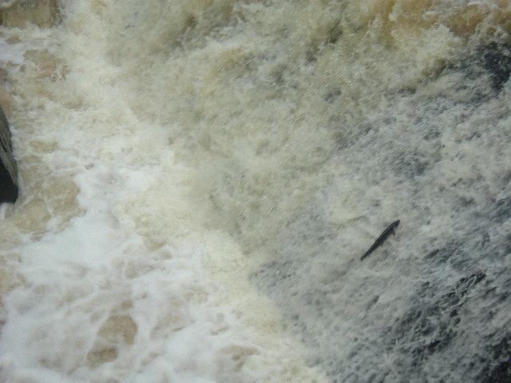
Stanley Howe - Creative Commons Attribution-Share Alike 2.0 Generic
See: http://en.wikipedia.org/wiki/File:Salmon_negotiating_the_leap_by_Bridge_of_Feugh_-_geograph.org.uk_-_254864.jpg

Slide 24
Web reports
Usage of website, both aggregate and specific.
Downloads of podcasts.
Views of rich media.
Tweets and re-tweets.
Likes
Check-ins
…

Slide 25
Enough!
There are numerous people, systems, processes and services to manage and therefore measure.
There are numerous instruments/measures.
Abundance of data.
Countless questions.
With finite resources and time, where are the limits?

Slide 26
IMPACT

Slide 27
Impact of Social Sciences

Slide 28
About the project

Slide 29
Defining impacts

Slide 30
Impacts in context of web
“… recorded or otherwise auditable occasion of influence …”
[audience asked to contribute during presentation]

Slide 31
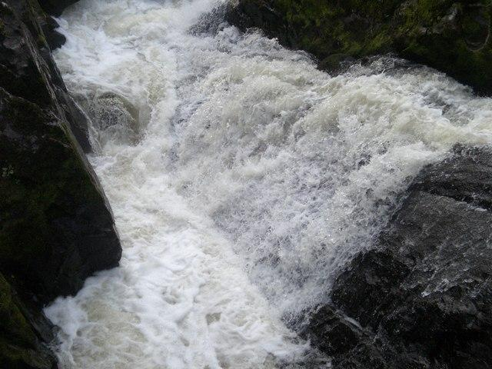
Lyn Mcleod - Creative Commons Attribution-Share Alike 2.0 Generic
See: http://commons.wikimedia.org/wiki/File:Falls_Of_Feugh_-_October_-_geograph.org.uk_-_580227.jpg?uselang=en-gb

Slide 32
FOCUS

Slide 33
Measured web presence
Audit what is managed (and distinguish it from what is not, if also in your audit).
Collect data for what is managed. Automate the collection of data and manage the collected data: storage, access and retention.
Enable authorised self-help access to data through reporting tools; negotiate direct access.
Focus on dashboards and investigations.

Slide 34
Examples of dashboards

Slide 35
More dashboards

Slide 36
Example of investigation

Slide 37
Tests

Slide 38
Results (1)

Slide 39
Results (2)

Slide 40
Results (3)

Slide 41
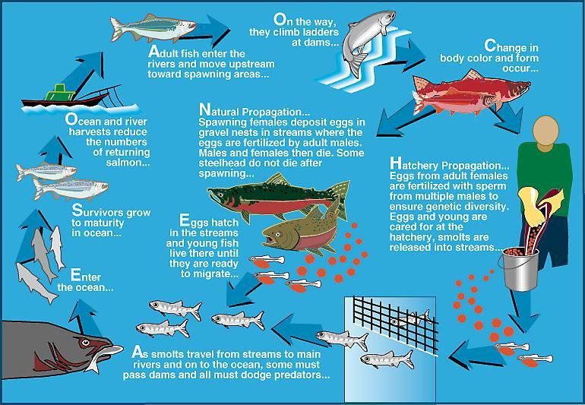
US Army Corps of Engineers - Public Domain
See: http://en.wikipedia.org/wiki/File:Life_cycle_of_Pacific_salmon.jpg

Slide 42
Impact
It is not the role of web managers to assess impact.
Provide data and tools to others so they can assess impact.
Focus on managing people, systems, processes and services.

Slide 43
Disclaimer
All fish where photographed leaping from Scottish rivers and are therefore assumed to be Scottish fish.

